Slide 1
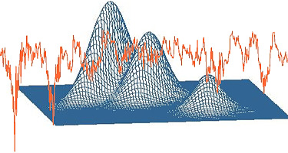

Applied statistics with applications in R (and SAS)
Alessio Cecchinato
Hugo Toledo Alvarado
DAFNAE - Department of Agronomy, Food
Natural resources, Animals and Environment
University of Padova

Slide 2
Overview
We will cover analysis of variance and analysis of covariance. The emphasis will be placed on selected practical tools using R software (and SAS) rather than on the mathematical manipulations. Want to understand the theory so that we can apply it appropriately

Slide 3
Overview
Introduction to hypothesis testing
How to state a null hypothesis and alternative hypothesis
How to identify errors and interpret the level of significance
Analysis of variance (ANOVA):
One-way ANOVA
Two-way ANOVA
Two-way ANOVA and interactions
ANCOVA
Exercises and applications with R software

Slide 4
Overview
Team Project:
Data will be provided to a team composed of two to three students and asked to employ techniques learned throughout this course to analyze the data set, interpret and report results
Final Exam:
Written examinations. A written examination consists of exercises designed to test the basic knowledge acquired during the course

Slide 5
References
R users:
Crawley, M. J. (2012). The R book. John Wiley & Sons.
Kabacoff, R. I. (2010). R in Action. Manning.
SAS users:
Text: Applied Linear Statistical Models, (4th ed.) by Neter, Kutner, Nachtsheim and Wasserman
SAS System for Regression (2nd ed.) by Freund and Little
SAS/STAT User’s Guide Vol. 1 and 2

Slide 6

A brief introduction: Scientific Method
a) Review and Research the problem
b) Formulate Hypothesis
c) Design experiment that will allow test of hypothesis
d) Evaluate the hypothesis
e) Draw Conclusions

Slide 7
How does statistical inference work?
Infer upon the characteristics of a large population based on data from a finite random sample
Mechanics (part of the scientific method):
Design and collect data from an experiment (e.g blood pressure)
Assess the probability of getting the experimental results assuming a true null hypothesis (status quo knowledge..e.g. no treatment difference )
Common investigator objective: disprove the status quo in favor of an alternative hypothesis (there is a treatment effect)
Conclusions never made with absolute certainty…must establish proof beyond a reasonable doubt

Slide 8
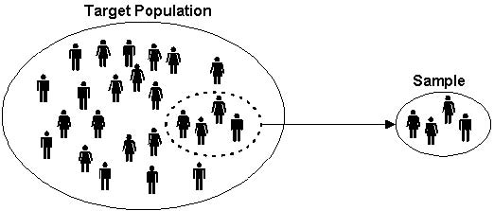
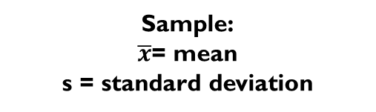
Terminology
Population: The collection of all responses, measurements, or counts that are of interest
Sample: A portion or subset of the population
Population:
μ= mean
σ= standard deviation
Sample:
$\overline{x}$= mean
s = standard deviation

Slide 9
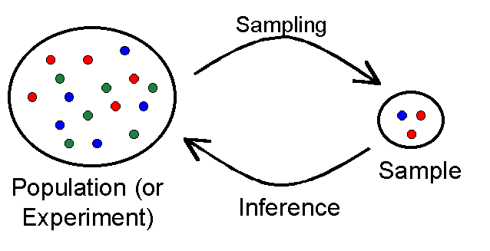
Populations and samples
Notes:
Inferential statistics centres around using a sample of subjects to represent a population. A population is the group of interest. A random selection from this population is called a sample. Statistics such as the mean and standard deviation are calculated using the sample data and used to estimate the population parameters.

Slide 10
Do it yourself …
Identify the population and the sample in the following example: In a recent survey 2000 European Boxer dogs owners were asked if they submitted their dogs to x-ray screening for hip dysplasia. Eight hundred of the owners answered yes
What is the population ?
What is the sample ?
What is the data set

Slide 11
Variables, Variables!!!
Quantitative variables:
Due to a true numerical measurement
Ratio scale (e.g. weight) versus Interval Scale (e.g. temperature)
Discrete (countable) versus Continuous
Qualitative variables:
Nominal scale (classification or group) GENOTYPE, SEX
Ordinal scale (ranked variables..small, medium, large)

Slide 12




Data types
Variables
Scale
Categorical
Continuous
Measurements
takes any value
Discrete:
Counts/ integers
Ordinal:
obvious order
Nominal:
no meaningful order

Slide 13
Questionnaire
What data types relate to following questions?
Q1: What is your favourite subject?
Q2: Gender:
Q3: I consider myself to be good in statistics:
Q4: Score in a recent exam:
Nominal
Maths | English | Science | Art | French
Male | Female
Binary/ Nominal
Strongly Disagree | Disagree | Not Sure | Agree | Strongly Agree
Ordinal
Score between 0% and 100%
Scale
Notes:
The answers. Point out that binary variables are a special case of nominal variables.
Ordinal variables are the one students get most confused about. Make it clear that although we usually number categorical variables in SPSS, this does not make them scale. The numbers are just labels. People come 1st, 2nd, 3rd etc in a race but the distance between 1st and 2nd may not be the same as the distance between 2nd and 3rd.

Slide 14

A (practical ) introduction to hypothesis testing

Slide 15
Hypothesis tests
A hypothesis test is a process that uses sample statistics to test a claim about the value of population parameter
Example: suppose an automobile manufacturer advertises that its new hybrid car has a mean gas mileage of 50 miles per gallon.
If you suspect that the mean mileage is not 50 miles per gallon, how could you show that the advertisement is false?
Obviously, you cannot test all the vehicles, so we draw a sample from the population …
There is a large probability that the value of the sample statistic differs from the that of the claim. Is it enough to conclude that the claim is wrong ?

Slide 16
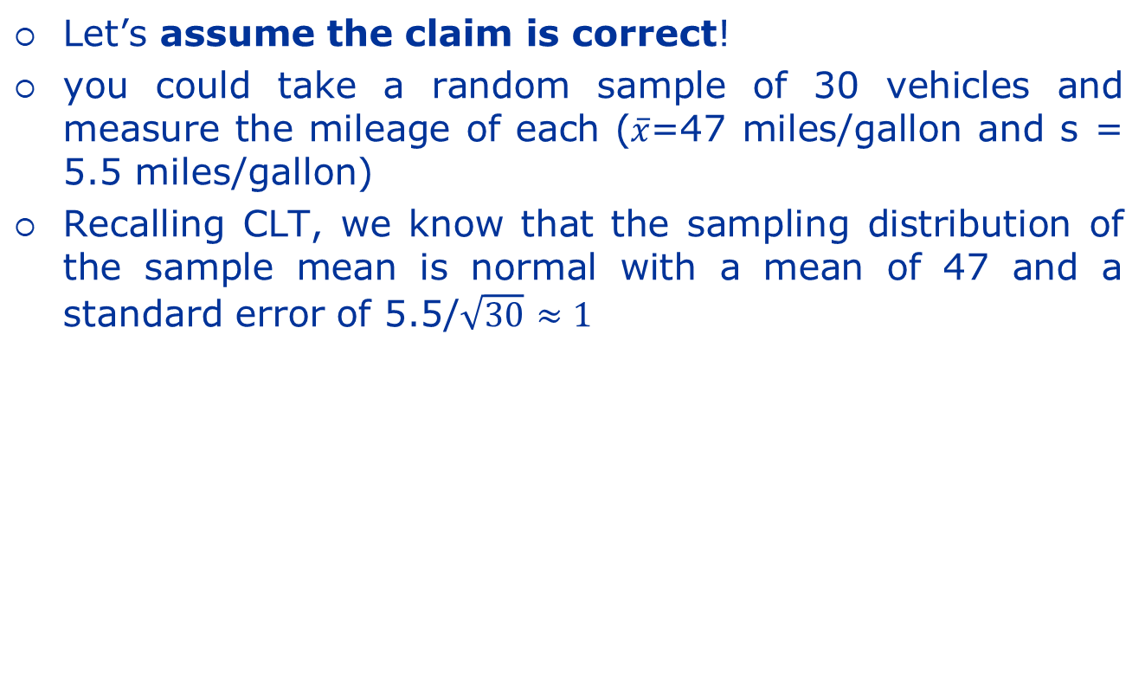
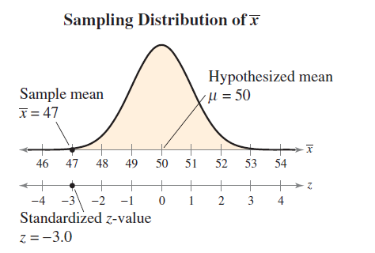
Hypothesis tests
So either the sample is very unusual or the claim is false

Slide 17

Hypothesis tests
This is an unusual event!
Your assumption that the company’s advertisement is correct has led you to an improbable result. So, either you had a very unusual sample, or the advertisement is probably false.
The logical conclusion is that the advertisement is probably false

Slide 18
Stating a hypothesis
A claim about a population parameter is called a statistical hypothesis
To test a statistical hypothesis, we must carefully state a pair of hypotheses:
the claim
its complement
When the first is true, the other is false
Of the two hypotheses, the one that contains a statement of equality (=, ≤, ≥) is called the null hypothesis (H₀), the other one (≠, <, >) is the alternative hypothesis (H_{a})

Slide 19
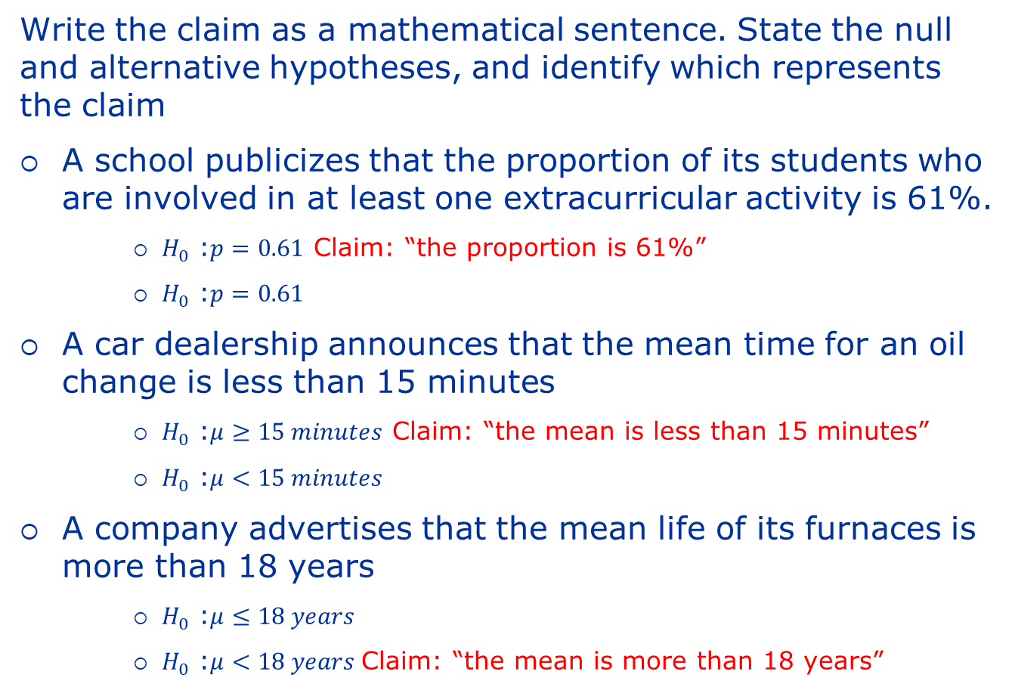
Examples
Write the claim as a mathematical sentence. State the null and alternative hypotheses, and identify which represents the claim
A school publicizes that the proportion of its students who are involved in at least one extracurricular activity is 61%.
$H_{0 }$:$p=0.61$ Claim: “the proportion is 61%”
$H_{0 }$:$p=0.61$
A car dealership announces that the mean time for an oil change is less than 15 minutes
$H_{0 }$:$μ≥15 minutes$ Claim: “the mean is less than 15 minutes”
$H_{0 }$:$μ<15 minutes$
A company advertises that the mean life of its furnaces is more than 18 years
$H_{0 }$:$μ≤18 years$
$H_{0 }$:$μ<18 years$Claim: “the mean is more than 18 years”

Slide 20
Types of errors and level of significance
We always test the null hypothesis H₀
So, after the test, we make one of two possible decisions:
reject the null hypothesis or
fail to reject the null hypothesis
Because the decision is based on incomplete information (the sample) there is always the chance of making the wrong decision
There are two types of errors we can make:
A type I error occurs if the null hypothesis is rejected when it is true
A type II error occurs if the null hypothesis is not rejected when it is false

Slide 21
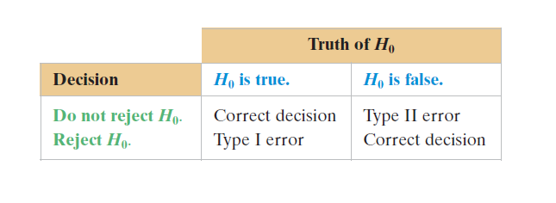
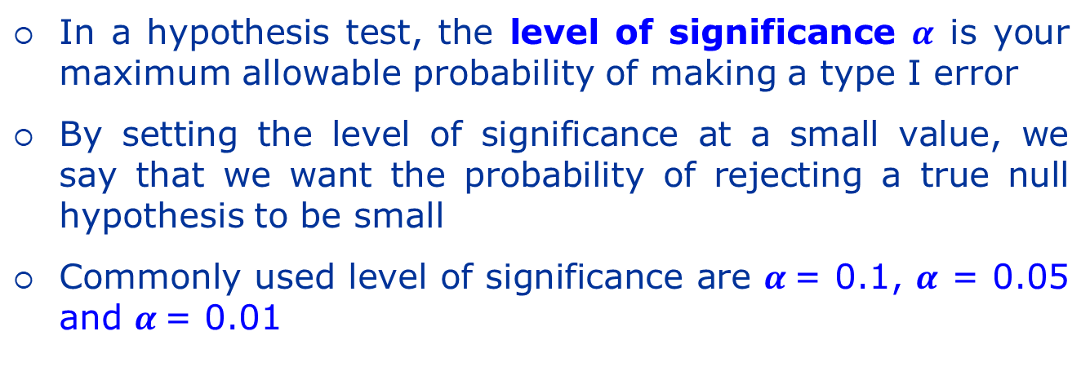
Types of errors and level of significance
Controlled via sample size
(=1-Power of test)
Typically restrict to a 5% Risk
= level of significance
Prob of this = Power of test

Slide 22
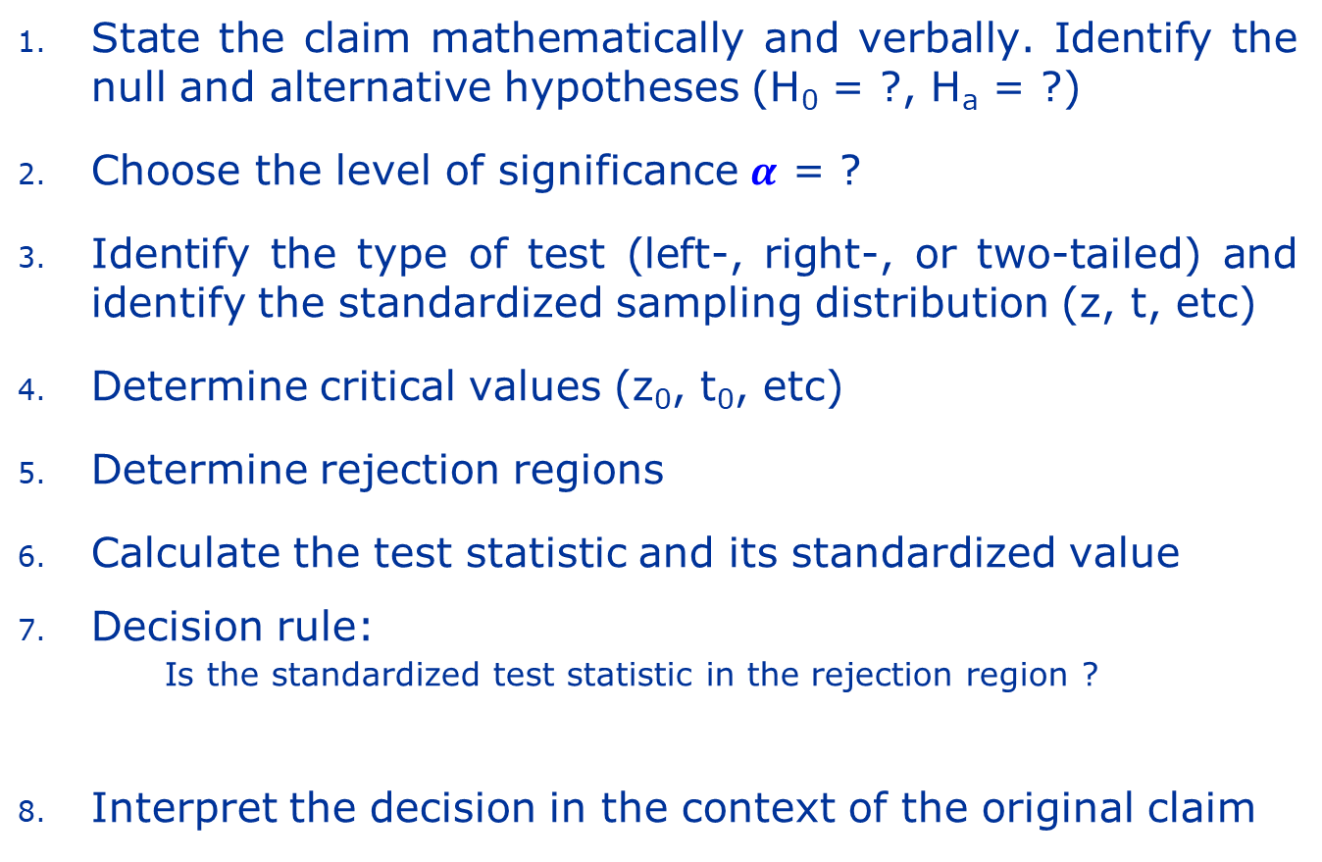
Summary for hypothesis testing
Yes
Reject H₀
No
Fail to reject H₀

Slide 23
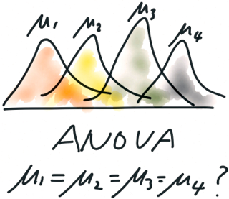
Analysis of variance (ANOVA)

Slide 24
Analysis of variance (ANOVA)
Analysis of variance (ANOVA) is a hypothesis-testing technique that is used to compare means from three or more populations
The response variable Y is continuous
The explanatory variable is categorical
We call it a factor
The possible values are called levels
This approach is a generalization of the independent two-sample t-test
In other words, it can be used when there are more than two treatments

Slide 25
Analysis of variance (ANOVA)
A factor refers to a categorical quantity under examination in an experiment as a possible cause of variation in the response variable
Levels refer to the categories, measurements, or strata of a factor of interest in the experiment

Slide 26
Data for One-Way ANOVA
Y is the response variable
X is the factor (it is qualitative/discrete)
r is the number of levels
often refer to these levels as groups or treatments
Y_{ij} is the j^{th} observation in the i^{th} group

Slide 27
Notation
For Y_{i,j} we use
i to denote the level of the factor
j to denote the j^{th} observation at factor level i
i = 1, . . . , r levels of factor X
j = 1, . . . , n_{i} observations for level i of factor X

Slide 28
Types of Experimental Designs
Experimental
Designs
Completely Randomized
Randomized Block
Factorial
One-Way Anova
Two-Way Anova

Slide 29

Completely Randomized Design

Slide 30
Blood cholestorol example
Experimental study with randomization:
6 rats assigned at random to one of 2 treatments (n=3 rats per treatment)
Blood Cholestorol Data collected (mg/dl):
Would you conclude the treatments lead to different mean blood cholestorol levels ????
New Treatment (A)
Control Treatment (B)
y_{A1} = 144
B1
A1
y_{B1} = 149
y_{A2} = 148
B2
A2
y_{B2} = 148
y_{A3} = 146
B3
A3
y_{B3} = 159
Ave y_{A} = 146
Ave y_{B} = 152

Slide 31
A mean treatment difference is found!
But is it…….
Due to mere chance (biological noise) ???
Or…
The real thing (beyond reasonable doubt)?
Statistical inference

Slide 32
Completely Randomized Design
Experimental units (subjects) are assigned randomly to treatments
Subjects are assumed homogeneous
One factor or independent variable
2 or more treatment levels or groups
Analyzed by one-way ANOVA

Slide 33
One-Way ANOVA F-Test
Tests the equality of 2 or more (p) population means
Variables
One nominal independent variable
One continuous dependent variable

Slide 34
One-Way ANOVA F-Test Assumptions
Randomness & independence of errors
Normality
Populations (for each condition) are normally distributed
Homogeneity of variance
Populations (for each condition) have equal variances

Slide 35
Assumption
(1)
y is a linear function of a,β,x₁, …, x_{n} and e (residual)
(2)
e does not depend on x₁, …, x_{n} (e and x₁, …, x_{n} are not correlated)
(3)
Omoscedasticy assumption: the variance of e is equal for all the observations
(4)
The residual of each observation is not related with the residual of other observations
(5)
The residuals are normally distributed

Slide 36
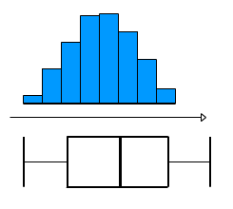
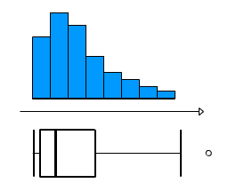
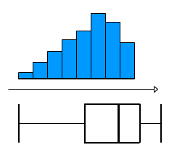
Assessing Normality
Charts can be used to informally assess whether data is:
Normally
distributed
Or….Skewed
The mean and median are very different for skewed data
Notes:
normality is an important issue in statistics. This can be assessed graphically using a histogram or box-plot. The first pair show a perfect normal distribution. When assessing normality, we are only concerned with data that is very skewed as in the second and third pairs of graphs. Comparing means and medians can also help as the wider apart they are the more skewed the data is.

Slide 37
Normality test
Wide variety of tests we can perform to test if the data follows a normal distribution
Mardia (1980) provides an extensive list for both the univariate and multivariate cases, categorizing them into two types
Properties of normal distribution, more specifically, the first four moments of the normal distribution
Shapiro-Wilk’s W (compares the ratio of the standard deviation to the variance multiplied by a constant to one)
Goodness-of-fit tests,
Kolmogorov-Smirnov D
Cramer-von Mises W²
Anderson-Darling A²
Mardia, K.V. (1980): Tests of univariate and multivariate normality. In P.R. Krishnaiah (ed.), Handbook of statistics (vol. 1; pp 279-320). Amsterdam: North Holland.

Slide 38

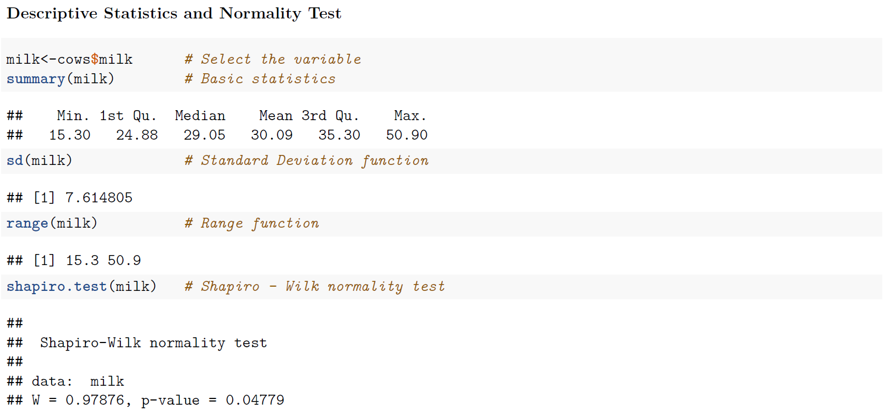
Normality test

Slide 39
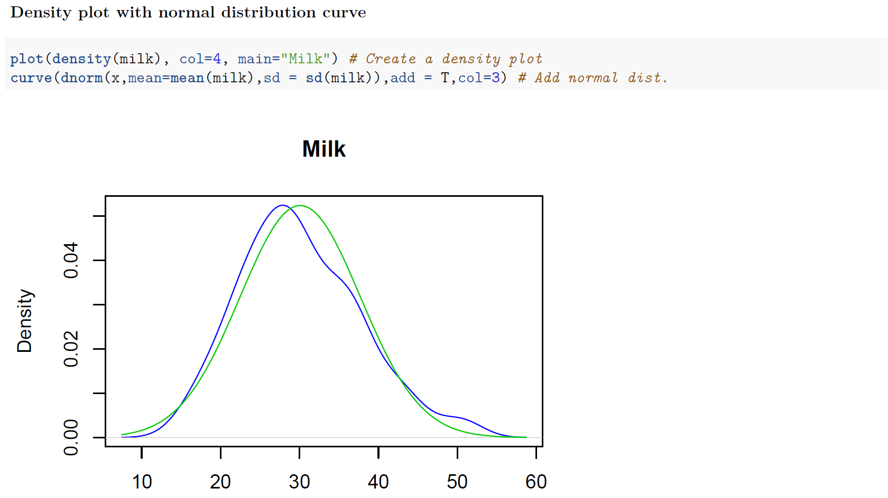
Normality test

Slide 40
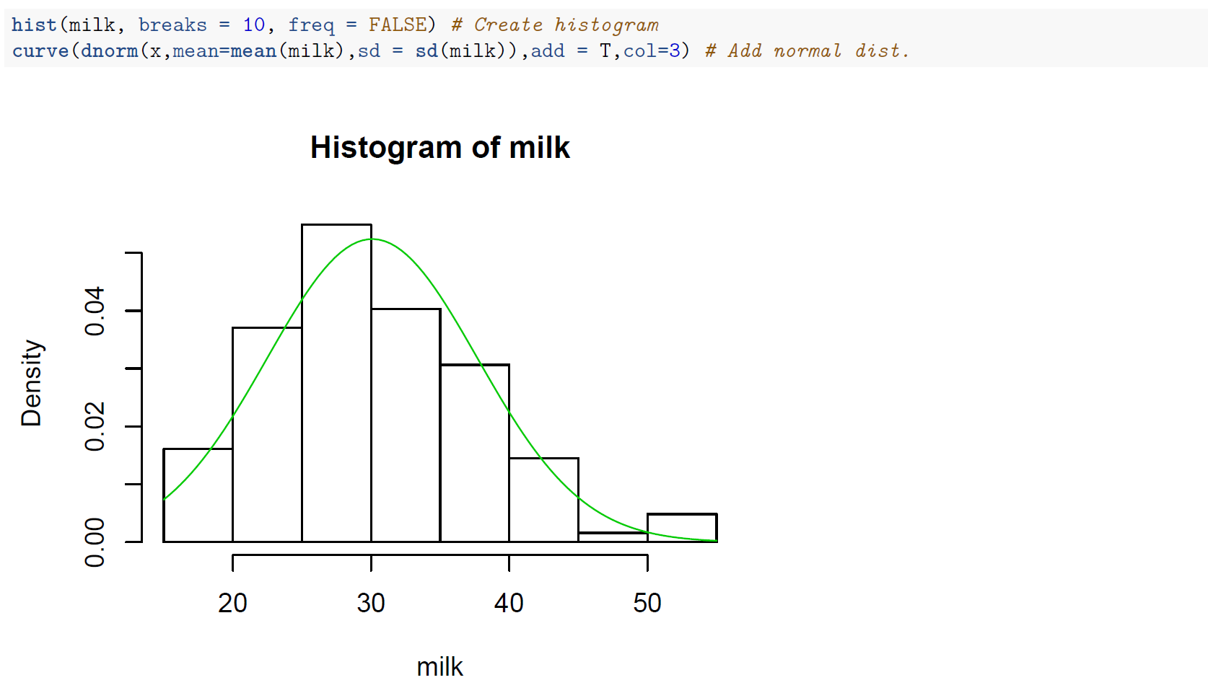
Normality test

Slide 41
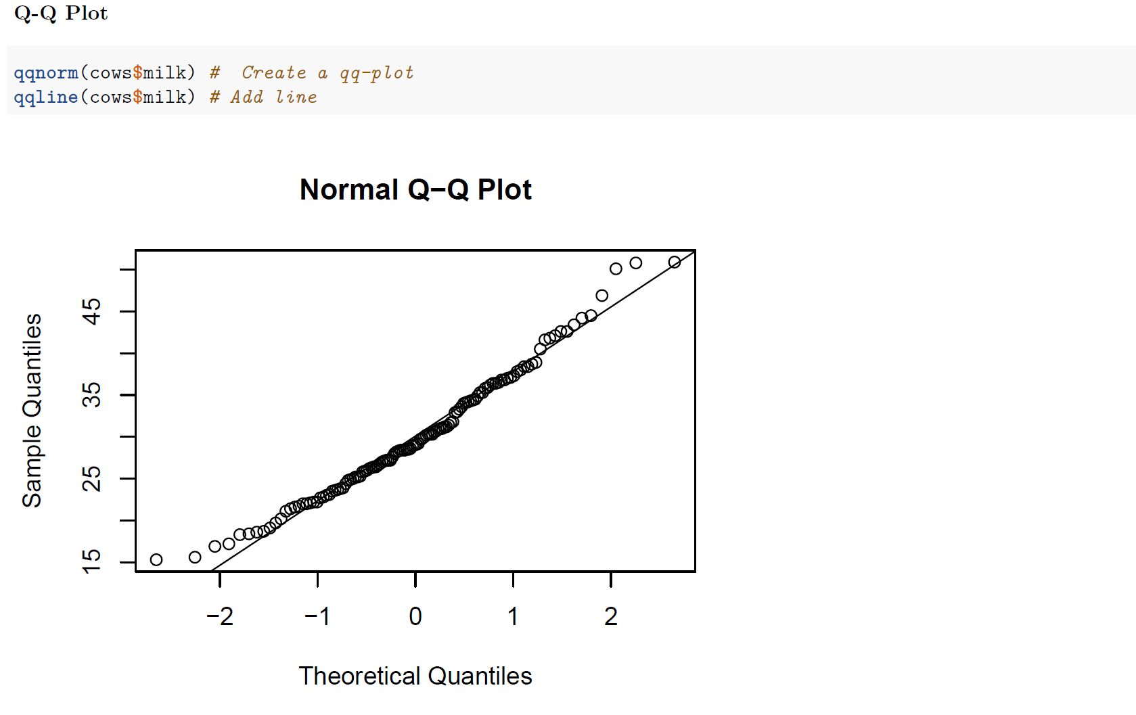
Normality test

Slide 42

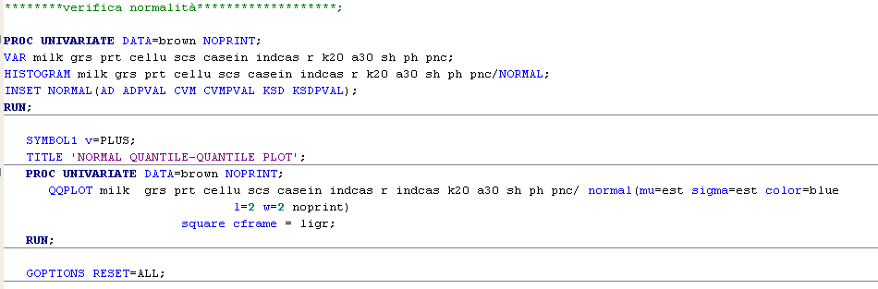
Normality test

Slide 43
Normality test

Slide 44
Consequences of Non-Normality
F-test is very robust against non-normal data, especially in a fixed-effects model
Large sample size will approximate normality by Central Limit Theorem (recommended sample size > 50)
Simulations have shown unequal sample sizes between treatment groups magnify any departure from normality
A large deviation from normality leads to hypothesis test conclusions that are too liberal and a decrease in power and efficiency

Slide 45
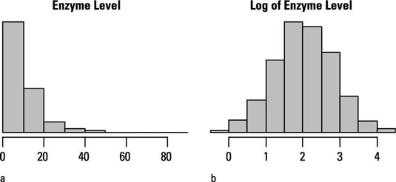
Remedial Measures for Non-Normality
Data transformation (log, square root, etc…)
Be aware - transformations may lead to a fundamental change in the relationship between the dependent and the independent variable and is not always recommended

Slide 46
One-Way ANOVA F-Test Hypotheses
f(X)
H₀: μ₁ = μ₂ = μ₃ = ... = μ_{p}
All Population Means are Equal
No Treatment Effect
H_{a}: Not All μ_{j} Are Equal
At Least 1 Pop. Mean is Different
Treatment Effect
ΝΟΤ μ₁ ≠ μ₂ ≠ ... ≠ μ_{p}
μ
=
μ
=
μ
1
2
3
f(X)
μ
=
μ
μ
1
2
3

Slide 47
One-Way ANOVA Basic Idea
Compares 2 types of variation to test equality of means
If treatment variation is significantly greater than random variation then means are not equal
Variation measures are obtained by ‘partitioning’ total variation

Slide 48
One-Way ANOVA Partitions Total Variation
Total variation
Variation due to treatment (MS_{B})
Variation due to random sampling
Sum of squares due to treatment SST (i.e, between groups)
Sum of squares error SSE (i.e, within groups)

Slide 49
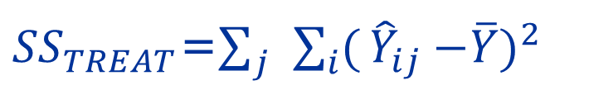



One-Way ANOVA Partitions Total Variation
${SS}_{ERROR}$=$\sum_{j}{\sum_{i}{(Y_{ij}}}$-${\hat{Y}}_{ij})^{2}$
$$+$$
${SS}_{TREAT}$=$\sum_{j}{\sum_{i}{(}}{\hat{Y}}_{ij}{−\overline{Y})}^{2}$
${SS}_{TOTAL}$=$\sum_{j}{\sum_{i}{(Y_{ij}}}{−\overline{Y})}^{2}$

Slide 50
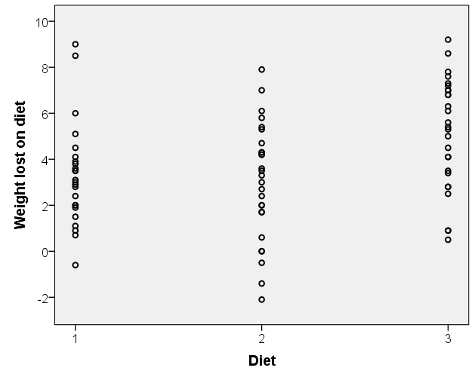

Within group variation
Residual =difference between an individual and their group mean
${SS}_{ERROR}$=$\sum_{j}{\sum_{i}{(Y_{ij}}}$-${\hat{Y}}_{ij})^{2}$
Person lost 9.2kg kg so residual =9.2 – 5.15 = 4.05
Mean weight lost on diet 3 = 5.15kg

Slide 51
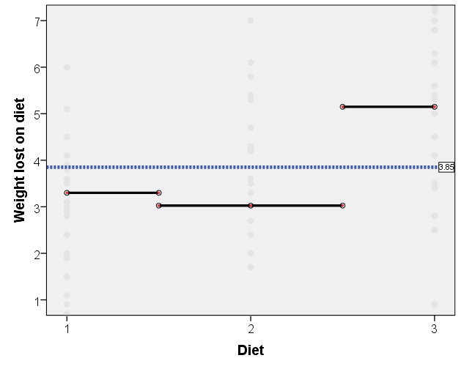
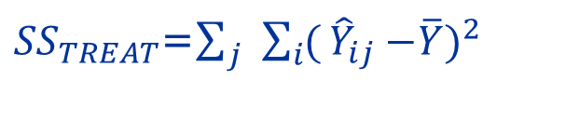
Between group variation
Differences between each group mean and the overall mean
${SS}_{TREAT}$=$\sum_{j}{\sum_{i}{(}}{\hat{Y}}_{ij}{−\overline{Y})}^{2}$
Diet 3 difference =5.15 – 3.85 = 1.3
Overall mean = 3.85

Slide 52
One-Way ANOVA F-Test
1. Test Statistic
F = MST / MSE
MST Is Mean Square for Treatment
MSE Is Mean Square for Error
2. Degrees of Freedom
df₁ = p -1
df₂= n - p
p = # Populations, Groups
n = Total Sample Size

Slide 53
One-Way ANOVA - Summary Table
Source of
Degrees
Sum of
Mean
F
Variation
of
Squares
Square
Freedom
(Variance)
Treatment
p - 1
SST
MST =
MST
SST/(p - 1)
MSE
Error
n - p
SSE
MSE =
SSE/(n - p)
Total
n - 1
SS(Total) =
SST+SSE

Slide 54
ANOVA – the sampling distribution for F
The sampling distribution for the test statistic F is an F (Snedecor) distribution with k-1 degrees of freedom (df_{N}) for the numerator (df_{N}) and N-k degrees of freedom for the denominator (df_{D})
The F distribution :
is a family of curve each of which determined by the df of the numerator and by the df of the denominator
is positively skewed
has a total area under the curve equal to 1
F-values are greater than or equal to zero
Its mean value is approximately equal to 1

Slide 55
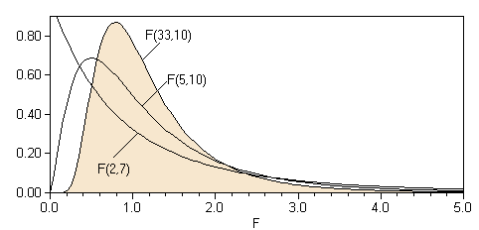
ANOVA – the sampling distribution for F

Slide 56
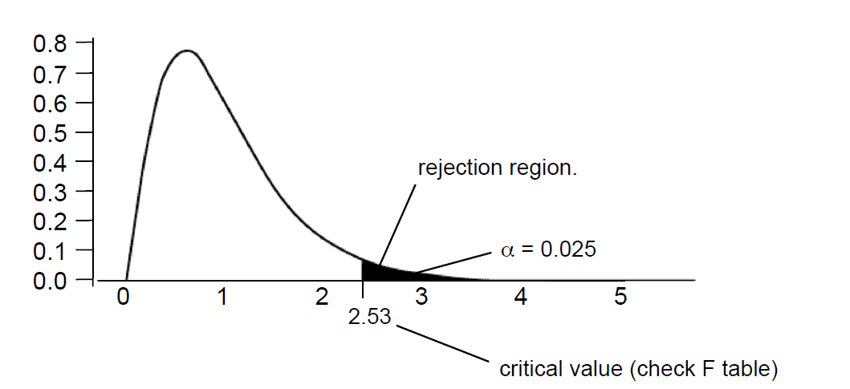
ANOVA – reject region
Example : an F distribution with df_{N}=15, df_{d} =21

Slide 57
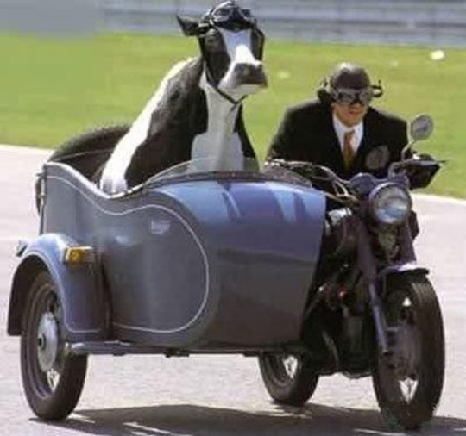
One-Way ANOVA F-Test Example
As a PhD student in animal and food science you want to see if 3 food supplements have different mean milk yields. You assign 15 cows, 5 per food supplement (CRD)
Question: At the .05 level, is there a difference in mean yields?
Food1 | Food2 | Food3
25.4 | 23.4 | 20
26.31 | 21.8 | 22.2
24.1 | 23.5 | 19.75
23.74 | 22.75 | 20.6
25.1 | 21.6 | 20.4

Slide 58
One-Way ANOVA F-Test Solution
H₀: μ₁ = μ₂ = μ₃
H_{a}: Not All Equal
α = .05
df₁ = 2 df₂ = 12
Critical Value(s):
Test Statistic:
Decision:
Conclusion:
MST
23
.
5820
F
=
=
=
25
.
6
MSE
.
9211
Reject at α = .05
α = .05
There Is Evidence Pop. Means Are Different
0
3.89
F

Slide 59
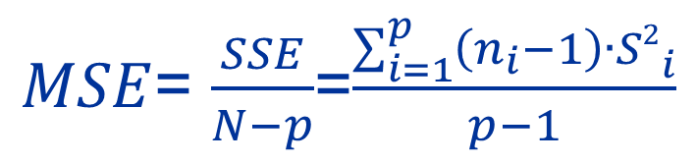
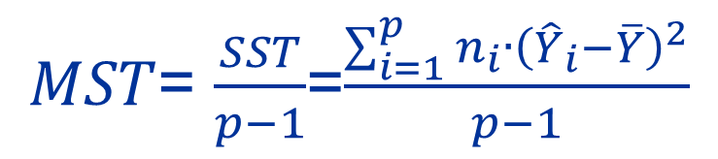
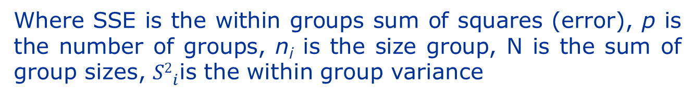
ANOVA - calculations
$MST$= $\frac{SST}{p−1}$=$\frac{\sum_{i=1}^{p}{n_{i}}∙{\left({\hat{Y}}_{i}−\overline{Y}\right)}^{2}}{p−1}$
Where SST is the between groups sum of squares, p is the number of groups and n_{i} is the size group
$MSE$= $\frac{SSE}{N−p}$=$\frac{\sum_{i=1}^{p}{\left(n_{i}−1\right)∙{S2}_{i}^{}}}{p−1}$
Where SSE is the within groups sum of squares (error), p is the number of groups, n_{i} is the size group, N is the sum of group sizes, ${S2}_{i}^{}$is the within group variance

Slide 60
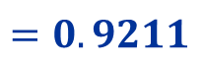
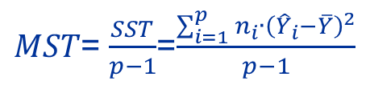
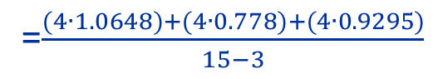
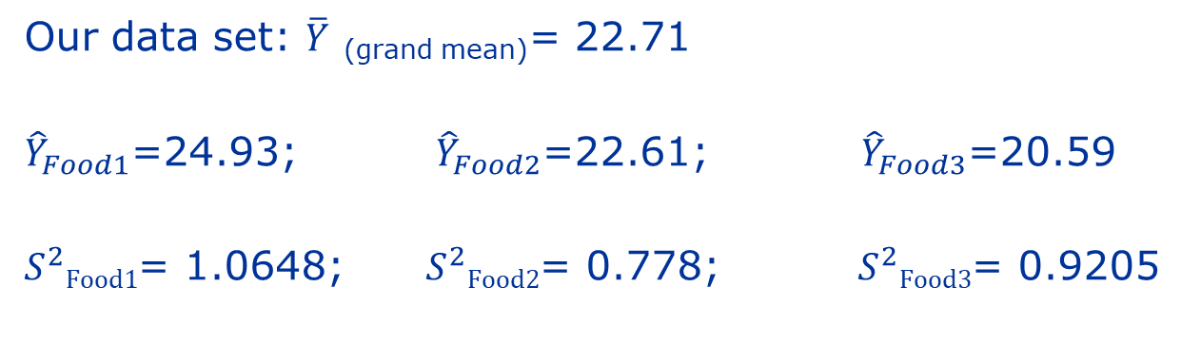
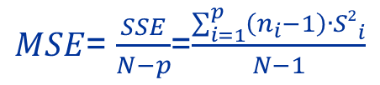
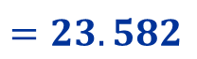
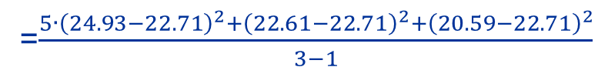
ANOVA - Example
Our data set: $\overline{Y}$ _{(grand mean)}= 22.71
${\hat{Y}}_{Food1}$=24.93; ${\hat{Y}}_{Food2}$=22.61; ${\hat{Y}}_{Food3}$=20.59
$S_{}^{2}Food1$= 1.0648; $S_{}^{2}Food2$= 0.778; $S_{}^{2}Food3$= 0.9205
$MST$= $\frac{SST}{p−1}$=$\frac{\sum_{i=1}^{p}{n_{i}}∙{\left({\hat{Y}}_{i}−\overline{Y}\right)}^{2}}{p−1}$
=$\frac{5∙{\left(24.93−22.71\right)}^{2}{+\left(22.61−22.71\right)}^{2}{+\left(20.59−22.71\right)}^{2}}{3−1}$
$$=23.582$$
$MSE$= $\frac{SSE}{N−p}$=$\frac{\sum_{i=1}^{p}{\left(n_{i}−1\right)∙{S2}_{i}^{}}}{N−1}$
=$\frac{(4∙1.0648)+(4∙0.778)+(4∙0.9295)}{15−3}$
$$=0.9211$$
${df}_{N}$=$p−1=3−1, { df}_{D}=N−p=15−3=12$

Slide 61
Summary Table Solution
Source of
Degrees of
Sum of
Mean
F
Variation
Freedom
Squares
Square
(Variance)
Food
3 - 1 = 2
47.1640
23.5820
25.60
Error
15 - 3 = 12
11.0532
.9211
Total
15 - 1 = 14
58.2172

Slide 62
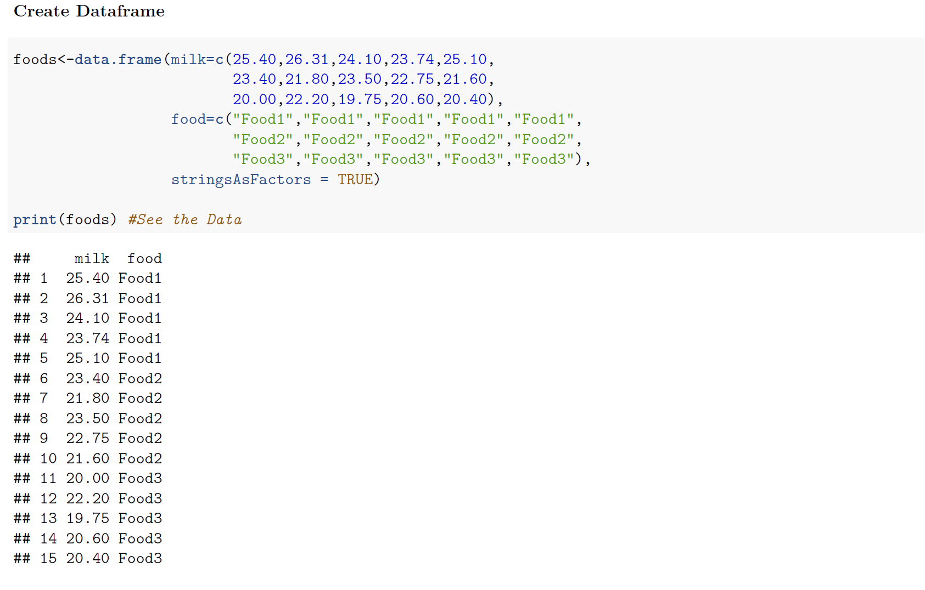
R CODES FOR ANOVA

Slide 63
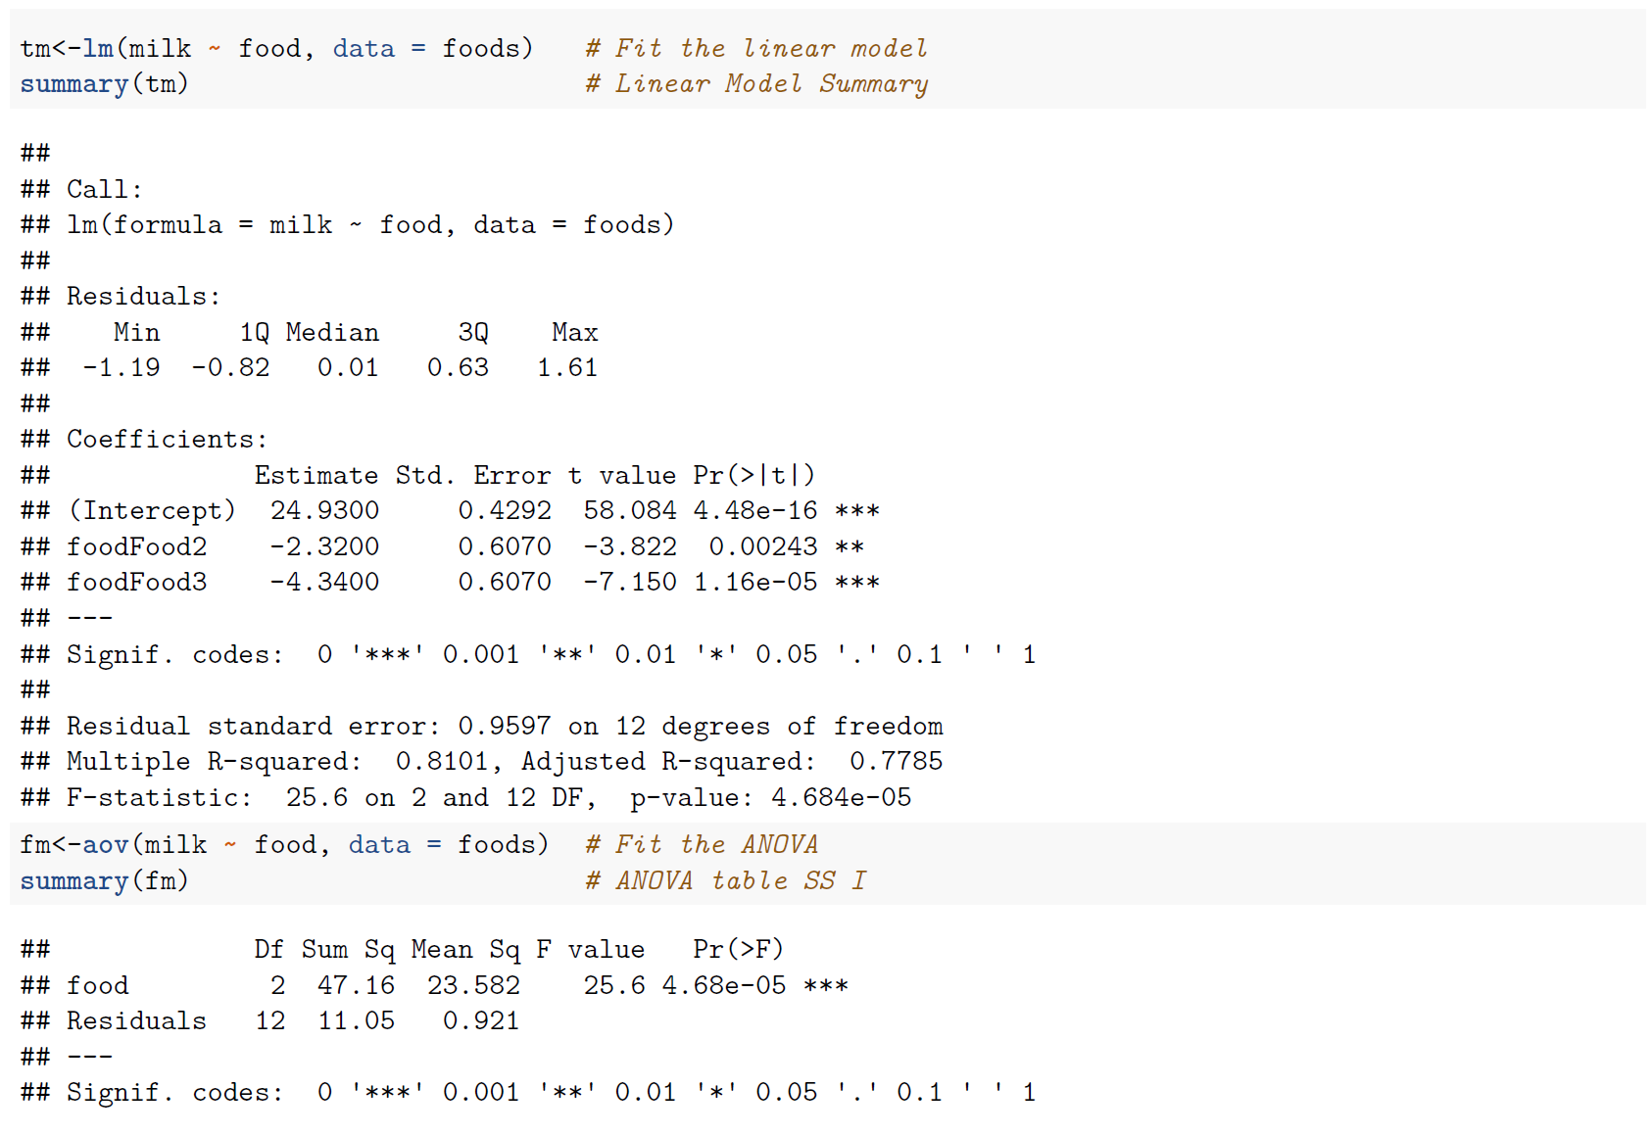
R OUTPUT - ANOVA

Slide 64
SAS CODES FOR ANOVA
Data Anova;
input group$ milk @@;
cards;
food1 25.40 food2 23.40 food3 20.00
food1 26.31 food2 21.80 food3 22.20
food1 24.10 food2 23.50 food3 19.75
food1 23.74 food2 22.75 food3 20.60
food1 25.10 food2 21.60 food3 20.40
;
run;
proc anova; /* or PROC GLM */
class group;
model milk=group;
run;

Slide 65
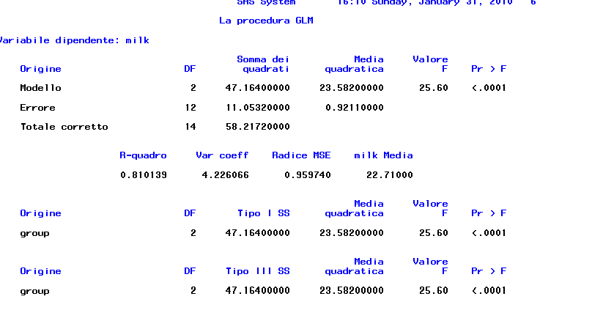
SAS OUTPUT - ANOVA

Slide 66
Pair-wise comparison
Needed when the overall F test is rejected
Can be done without adjustment of type I error if other comparisons were planned in advance (least significant difference - LSD method)
Type I error needs to be adjusted if other comparisons were not planned in advance (Bonferroni’s and scheffe’s methods)

Slide 67
Fisher’s Least Significant Difference (LSD) Test
To compare level 1 and level 2
Compare this to t_{α/2} = Upper-tailed value or - t_{α/2} lower-tailed from Student’s t-distribution for α/2 and (n - p) degrees of freedom
MSE = Mean square within from ANOVA table
n = Number of subjects
p = Number of levels

Slide 68
Bonferroni’s method
To compare level 1 and level 2
Adjust the significance level α by taking the new significance level α*

Slide 69
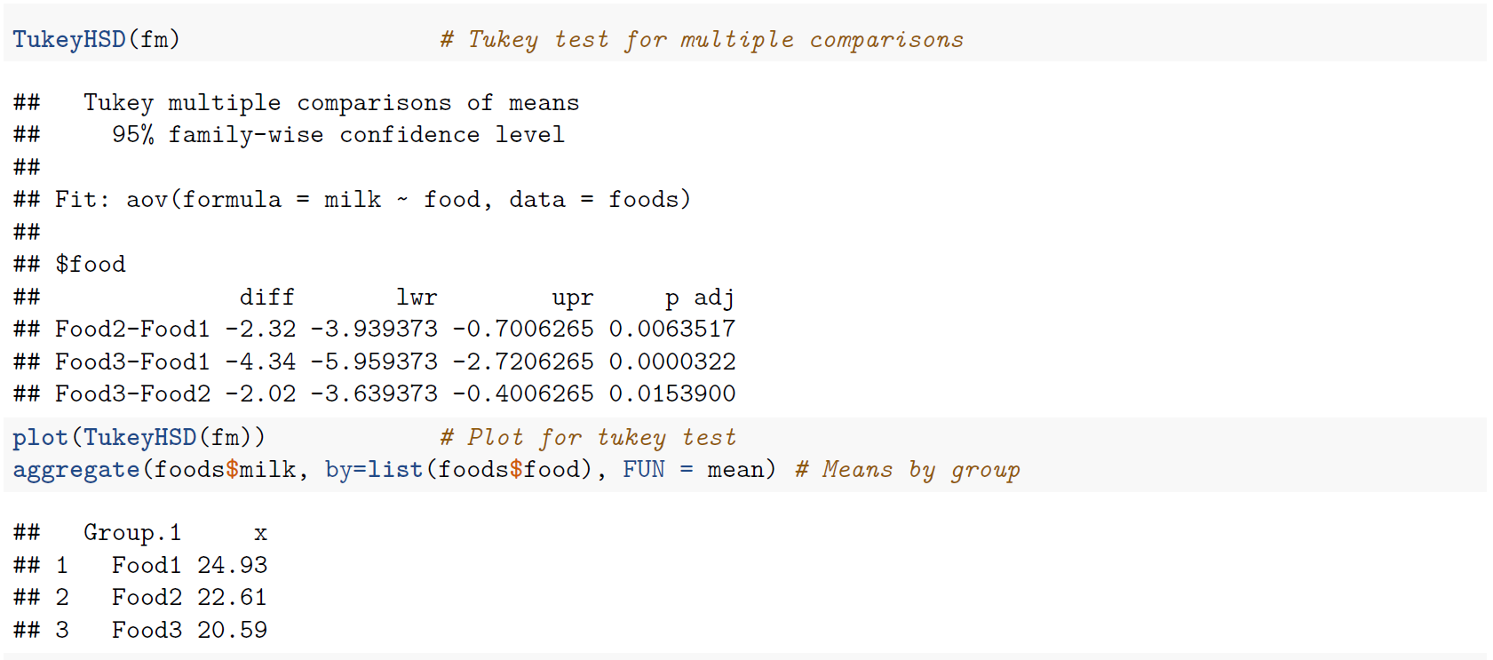
R CODES FOR multiple comparisons

Slide 70
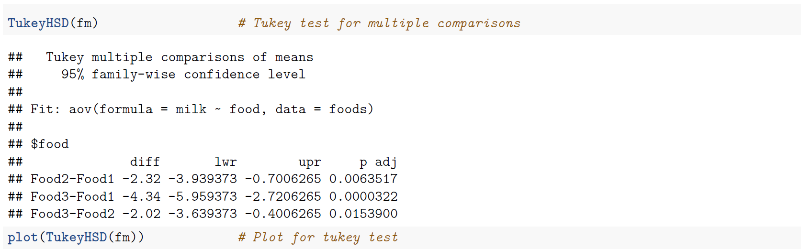
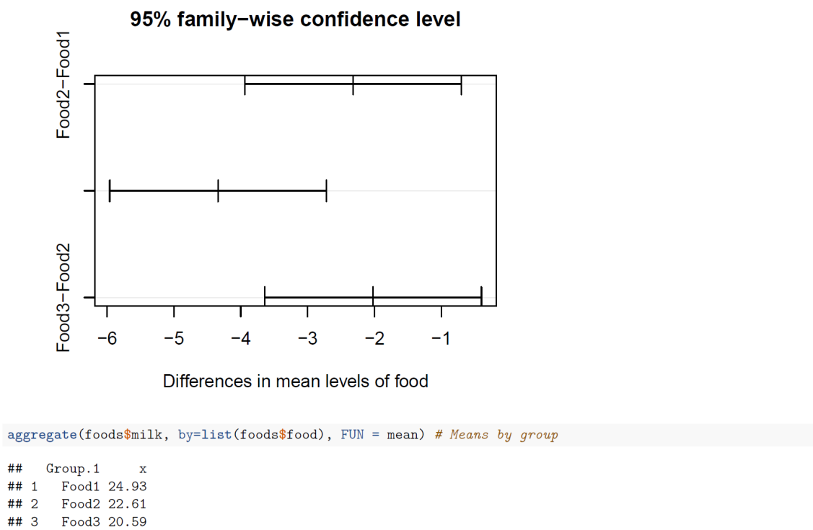
SAS OUTPUT - Tukey

Slide 71
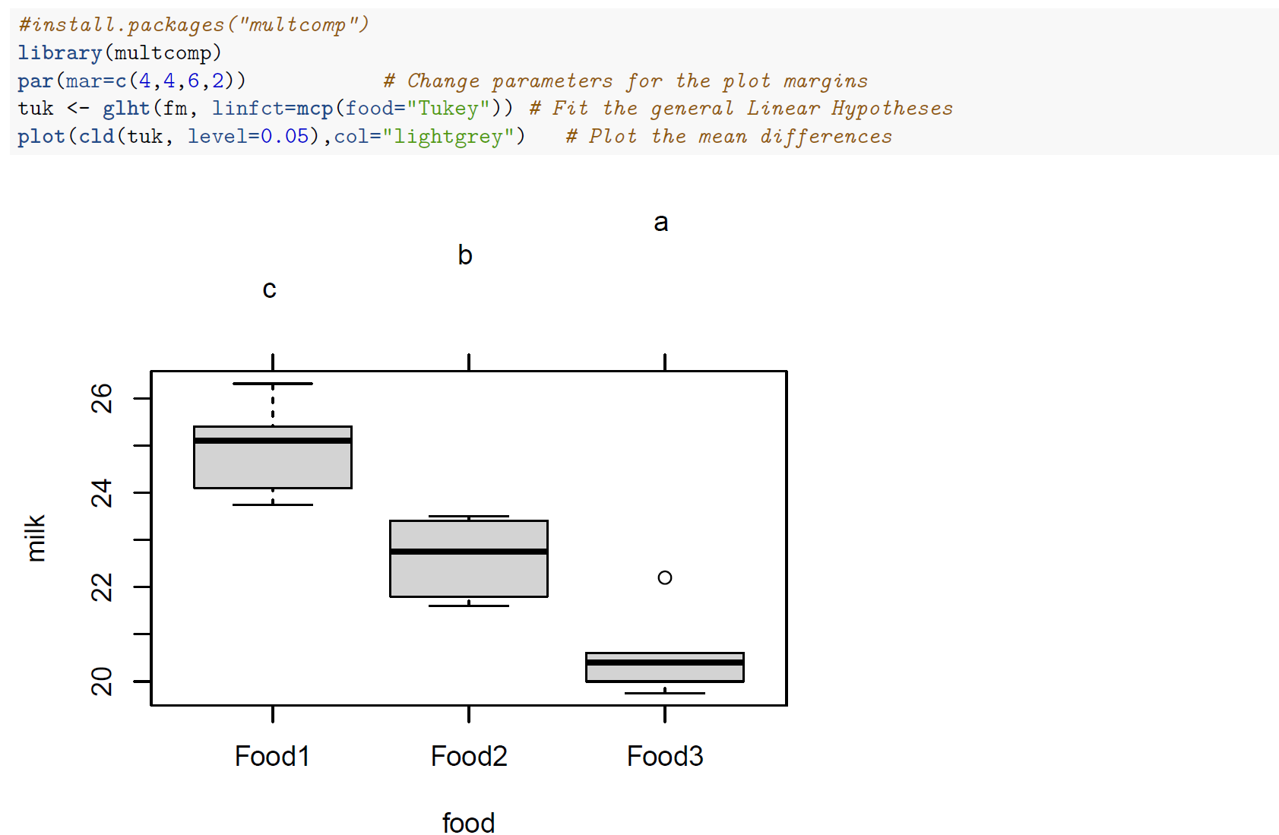
R Plot– Tukey differences

Slide 72
SAS CODES FOR multiple comparisons
proc glm;
class group;
model milk=group;
means group/ lsd bon;
run;

Slide 73
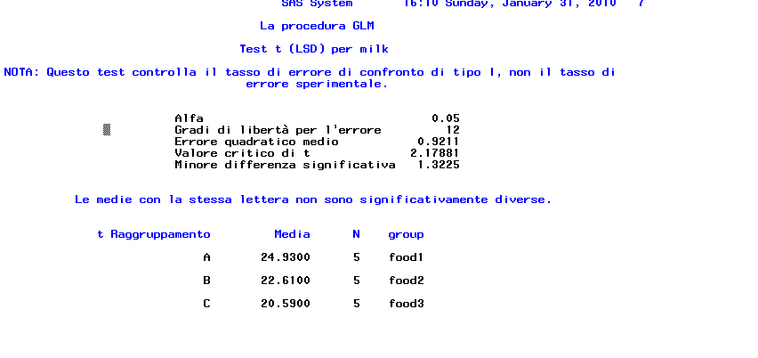
SAS OUTPUT - LSD

Slide 74
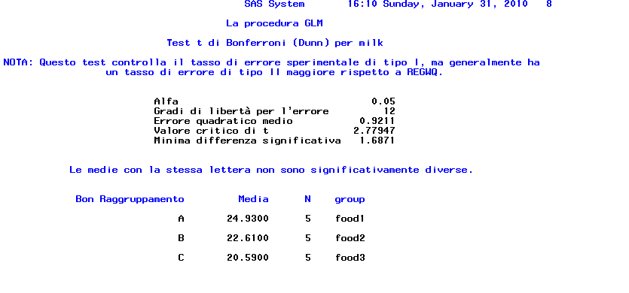
SAS OUTPUT - Bonferroni

Slide 75
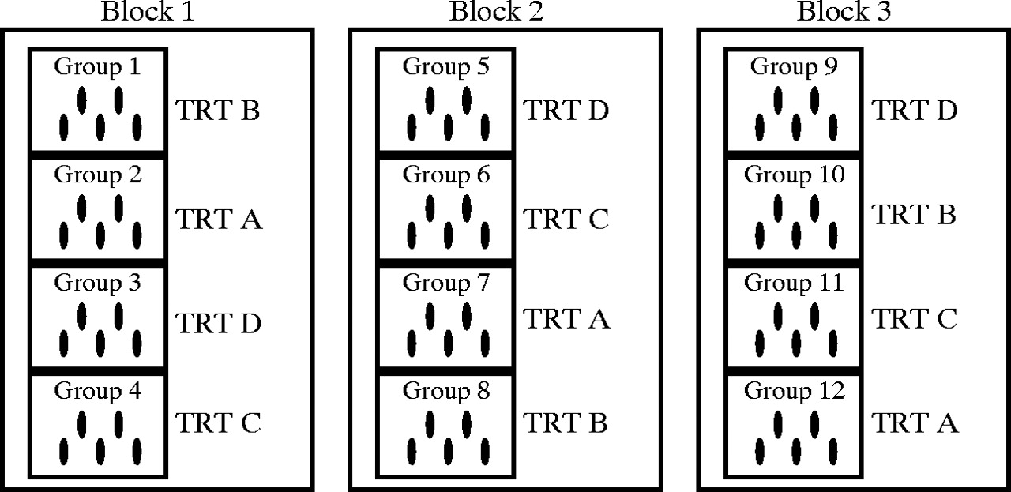
Randomized Block Design

Slide 76
Randomized Block Design
Experimental Units (Subjects) Are Assigned Randomly within Blocks
Blocks are Assumed Homogeneous
One Factor or Independent Variable of Interest
2 or More Treatment Levels or Classifications
One Blocking Factor

Slide 77
Randomized Block Design
Factor Levels: (Treatments) | A, B, C, D
Experimental Units | Treatments are randomly assigned within blocks
Block 1 | A | C | D | B
Block 2 | C | D | B | A
Block 3 | B | A | D | C
. . . | . . . | . . . | . . . | . . .
Block b | D | C | A | B

Slide 78

The Randomized Complete Block Design (RCBD)
Population of litters of size 2
Draw random sample of litters
Litter 1
Litter 2
Litter n
…
Trt A
Trt B
Trt B
Trt A
Trt A
Trt B
Randomly assign treatments to piglets within litters

Slide 79
Randomized Block F-Test
Tests the Equality of 2 or More (p) Population Means
Variables
One Nominal Independent Variable
One Nominal Blocking Variable
One Continuous Dependent Variable

Slide 80
Randomized Block F-Test Assumptions
Normality
Probability distribution of each block-treatment combination is normal
Homogeneity of variance
Probability distributions of all block-treatment combinations have equal variances

Slide 81
Randomized Block F-Test Hypotheses
f(X)
H₀: μ₁ = μ₂ = μ₃ = ... = μ_{p}
All Population Means are Equal
No Treatment Effect
H_{a}: Not All μ_{j} Are Equal
At Least 1 Pop. Mean is Different
Treatment Effect
μ₁ ≠ μ₂ ≠ ... ≠ μ_{p} Is wrong
X
μ
=
μ
=
μ
1
2
3
f(X)
X
μ
=
μ
μ
1
2
3

Slide 82
Two-Way ANOVA - Summary Table
Source of
Degrees of
Sum of
Mean
F
Variation
Freedom
Squares
Square
Treatment (a)
a - 1
SS(A)
MS(A)
MS(A)
MSE
Blocks (b)
b - 1
SS(B)
MS(B)
MS(B)
MSE
Error
(a-1)(b-1)
SS(E)
MS(E)
Total
N-1
SS(T)

Slide 83
Randomized Block F-Test Test Statistic
Test Statistic
F = MST / MSE
MST Is Mean Square for Treatment
MSE Is Mean Square for Error
Degrees of Freedom
df_{N} =p -1
df_{D}=n – b – p +1 or (p-1)(b-1)
p = # Treatments, b = # Blocks, N = Total Sample Size
Example: 15 piglets; weaned in 5 litters; treated with 3 treatments

Slide 84
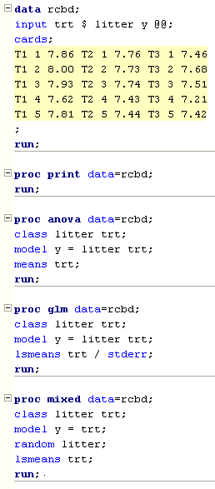
EXAMPLE and SAS CODE
Litter | T1 | T2 | T3
1 | 7.86 | 7.76 | 7.46
2 | 8.00 | 7.73 | 7.68
3 | 7.93 | 7.74 | 7.51
4 | 7.62 | 7.43 | 7.21
5 | 7.81 | 7.44 | 7.42
Alternatives: PROC ANOVA, GLM, MIXED,
ANALYST, INTERACTIVE DATA ANALYSIS

Slide 85
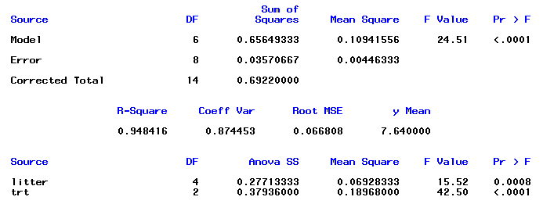
RESULTS (PROC ANOVA)
(Test for Fixed Effects)

Slide 86
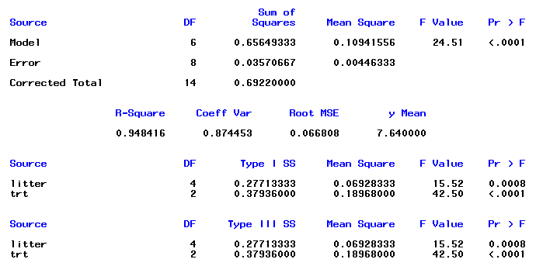
RESULTS (PROC GLM)
(Test for Fixed Effects)

Slide 87

EXAMPLE and R CODE
Litter | T1 | T2 | T3
1 | 7.86 | 7.76 | 7.46
2 | 8.00 | 7.73 | 7.68
3 | 7.93 | 7.74 | 7.51
4 | 7.62 | 7.43 | 7.21
5 | 7.81 | 7.44 | 7.42

Slide 88

(Test for Fixed Effects)

Slide 89

Factorial Design

Slide 90
Factorial Design
Experimental units (subjects) are assigned randomly to treatments
Subjects are assumed homogeneous
Two or more factors or independent variables
Each has 2 or more treatments (levels)
Analyzed by two-way ANOVA

Slide 91
Advantages of Factorial Designs
Saves time & effort
e.g., Could use separate completely randomized designs for each variable
Controls confounding effects by putting other variables into model
Can explore interaction between variables

Slide 92
Two-Way ANOVA
Tests the equality of 2 or more population means when several independent variables are used
Same results as separate one-way anova on each variable
But interaction can be tested

Slide 93
Two-Way ANOVA Assumptions
Normality
Populations are Normally Distributed
Homogeneity of Variance
Populations have Equal Variances
Independence of Errors
Independent Random Samples are Drawn

Slide 94
Two-Way ANOVA Data Table
Factor
Factor B
A
1
2
...
b
Observation k
1
Y
Y
...
Y
111
121
1b1
Y
Y
...
Y
Y_{ijk}
112
122
1b2
2
Y
Y
...
Y
211
221
2b1
Y
Y
...
Y
212
222
2b2
Level i Factor A
Level j Factor B
:
:
:
:
:
a
Y
Y
...
Y
a11
a21
ab1
Y
Y
...
Y
a12
a22
ab2

Slide 95
The two factor factorial Experiment
The model for a factorial experiment with two factors A and B is:
Where:
= observation k in level i of factor A and level j of factor B
= the overall mean
= the effect of level i of factor A
= the effect of level j of factor B
= the effect of the interaction of level i of factor A with level j of factor B
= random error with mean 0 and variance σ²
= number of levels of factor A; =number of levels of factor B;n =number of observation for each A x B combination

Slide 96
Two-Way ANOVA - Null Hypotheses
No Difference in Means Due to Factor A
H₀: μ_{1.} = μ_{2.} =... = μ_{a.}
No Difference in Means Due to Factor B
H₀: μ_{.1} = μ_{.2} =... = μ_{.b}
No Interaction of Factors A & B
H₀: AB_{ij} = 0

Slide 97
Two-Way ANOVA - Total Variation Partitioning
Total Variation
SS(Total)
Variation Due to Treatment A
Variation Due to Treatment B
SSA
SSB
Variation Due to Interaction
Variation Due to Random Sampling
SS(AB)
SSE

Slide 98
Two-Way ANOVA - Summary Table
Source of
Degrees of
Sum of
Mean
F
Variation
Freedom
Squares
Square
A
a - 1
SS(A)
MS(A)
MS(A)
(Row)
MSE
B
b - 1
SS(B)
MS(B)
MS(B)
(Column)
MSE
AB
(a-1)(b-1)
SS(AB)
MS(AB)
MS(AB)
(Interaction)
MSE
Error
ab(n-1)
SSE
MSE
Total
abn-1
SS(Total)
Same as Other Designs

Slide 99
Interaction
Occurs when effects of one factor vary according to levels of other factor
When significant, interpretation of main effects (A & B) is complicated
Can be detected
In data table, pattern of cell means in one row differs from another row
In graph of cell means, lines cross

Slide 100
Example: graphs of interaction – no interaction
+ 1.05 kg/d
+ 1.05 kg/d
T = 1
T = 2

Slide 101
Example: graphs of Interaction – positive interaction
+ 1.75 kg/d
+ 1.05 kg/d
T = 1
T = 2

Slide 102
Example: graphs of Interaction – negative interaction
+ 0.75 kg/d
+ 1.05 kg/d
T = 1
T = 2

Slide 103

Two-Way ANOVA F - Test Example
Vitamin I | 0 mg |  | 4 mg
Vitamin II | 0 mg | 5mg | 0 mg | 5 mg
 | 0.585 | 0.567 | 0.473 | 0.684
 | 0.536 | 0.545 | 0.450 | 0.702
 | 0.458 | 0.589 | 0.869 | 0.900
 | 0.486 | 0.536 | 0.473 | 0.698
 | 0.536 | 0.549 | 0.464 | 0.693

Slide 104

SAS OUTPUT - ANOVA

Slide 105

SAS OUTPUT - ANOVA

Slide 106

Two-Way ANOVA F - Test Example
Vitamin I | 0 mg |  | 4 mg
Vitamin II | 0 mg | 5mg | 0 mg | 5 mg
 | 0.585 | 0.567 | 0.473 | 0.684
 | 0.536 | 0.545 | 0.450 | 0.702
 | 0.458 | 0.589 | 0.869 | 0.900
 | 0.486 | 0.536 | 0.473 | 0.698
 | 0.536 | 0.549 | 0.464 | 0.693

Slide 107

R OUTPUT - ANOVA

Slide 108

R OUTPUT - LSM

Slide 109

Multiple Comparisons

Slide 110

Interaction Plot

Slide 111
Interaction
Vit I: 4 mg
Vit II: 5 mg
Vit I: 4 mg
Vit II: 0 mg
0.735 g
0.55 g
0.54 g
0.52 g
Vit I: 0 mg
Vit II: 0 mg
Vit I: 0 mg
Vit II: 5 mg
According to the figure interaction possibly exists, but probably the power is not enough to detect it. Most likely more than 5 measurement per group are needed

Slide 112

Analysis of covariance

Slide 113
Analysis of covariance
Statistical procedure in which variability of a dependent variable is explained by both categorical and continuous independent variables (covariate)
Common application of analysis of covariance is to adjust treatment means for known source of variability that can be explained by a continuous variable

Slide 114
Completely Randomized Design with a Covariate
In a CRD with a covariate the analysis of covariance is utilized for correcting treatment means, controlling the experimental error, and increase precision
Where:
= observation j in group i (treatment i)
= the intercept
= the regression coefficient
= a continuous independent variable with mean µ_{x} (covariate)
= the fixed effect of group or treatment i
= random error with mean 0 and variance σ²

Slide 115
Assumptions
Covariate is fixed and independent of treatments
Error are independent each other
Errors have a normal distribution with mean 0 and homogeneous variance σ²

Slide 116

CRD with a Covariate - example
Diet A |  | Diet B |  | Diet C
Initial weight (kg) | Gain (g/d) | Initial weight (kg) | Gain (g/d) | Initial weight (kg) | Gain (g/d)
350 | 970 | 390 | 990 | 400 | 990
400 | 1000 | 340 | 950 | 320 | 940
360 | 980 | 410 | 980 | 330 | 930
350 | 980 | 430 | 990 | 390 | 1000
340 | 970 | 390 | 980 | 420 | 1000

Slide 117


SAS OUTPUT

Slide 118

SAS OUTPUT

Slide 119

SAS OUTPUT

Slide 120

CRD with a Covariate - example
Diet A |  | Diet B |  | Diet C
Initial weight (kg) | Gain (g/d) | Initial weight (kg) | Gain (g/d) | Initial weight (kg) | Gain (g/d)
350 | 970 | 390 | 990 | 400 | 990
400 | 1000 | 340 | 950 | 320 | 940
360 | 980 | 410 | 980 | 330 | 930
350 | 980 | 430 | 990 | 390 | 1000
340 | 970 | 390 | 980 | 420 | 1000

Slide 121

R OUTPUT
It must be interpreted as ‘standard’ regression coefficient

Slide 122

ANOVA tables

Slide 123


Multiple comparisons

Slide 124

Plot for differences

Slide 125

Questions?

